Slide 1
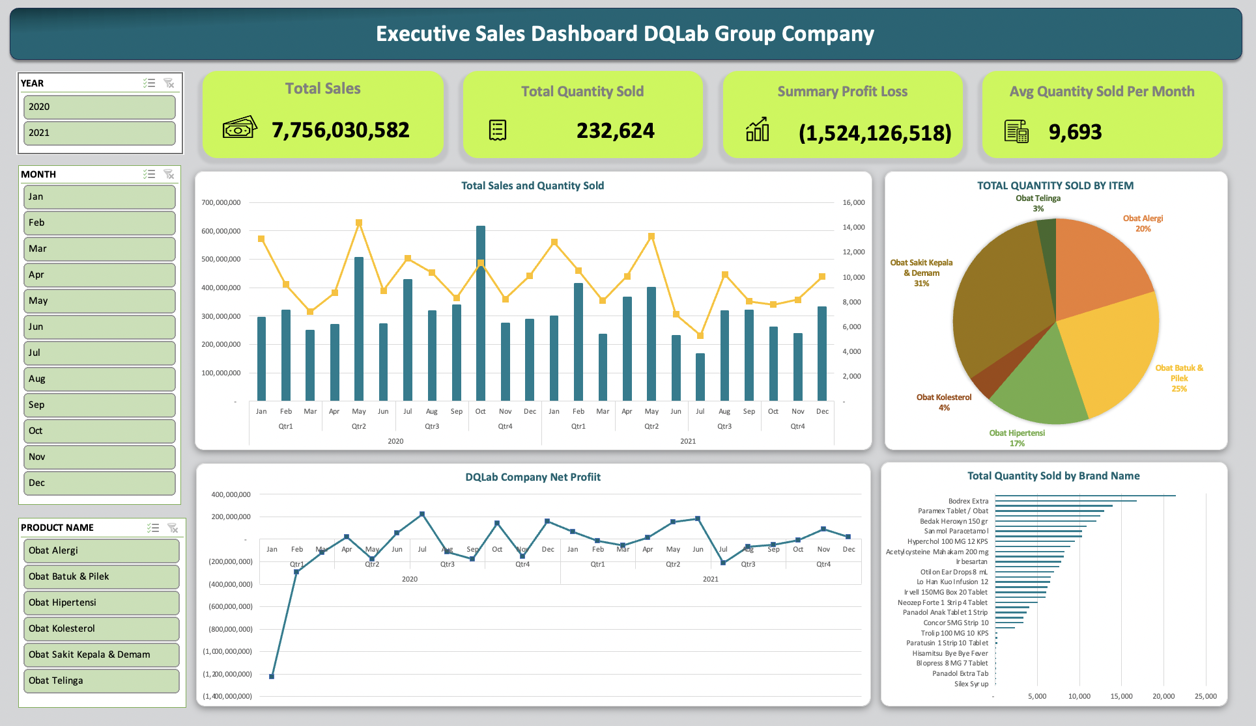

Slide 2
Drug Supply Chain Analysis
Excel Portfolio by :
Septi Windi
Final Project of Bootcamp Data Analysis with Microsoft Excel

Slide 3
Business Overview
Pharmacy as a business and professional practice is being presented with a large opportunity in the years to come. As a drug store, DQLab Group Company has sold hundreds of thousands of medicines to DQLab Hospital during 2 years of business from 2020 to 2021. Making its existence is important in helping people to get medicines.
At present DQLab Group Company have collaborated with sixteen suppliers from various pharmacy in Jakarta and surrounding. The company offers medicine for allergies and sinus, cough and cold, hypertension, cholesterol medication, headache pain relief and ear drop medicine.
The company wants to find out more about its business performance. Therefore, as a data analyst at DQLab Group Company, help the company to understand some business metrics such as profits, products, suppliers and give recommendations to set better goals.

Slide 4
Data Understanding
Dataset used for this project consist of 4 tables:
items.csv
suppliers.csv
Contains data on drug products available at DQLab Group Company and their selling prices
Contains data on suppliers available at DQLab Group Company from various regions in DKI Jakarta
item_supliers.csv
transaction.csv
Contains data on delivery time along with the buying price of drug products from each supplier
Contains data on the details of daily transactions for purchasing drug products from suppliers and selling drug products to DQLab Hospital during 2020- 2021

Slide 5
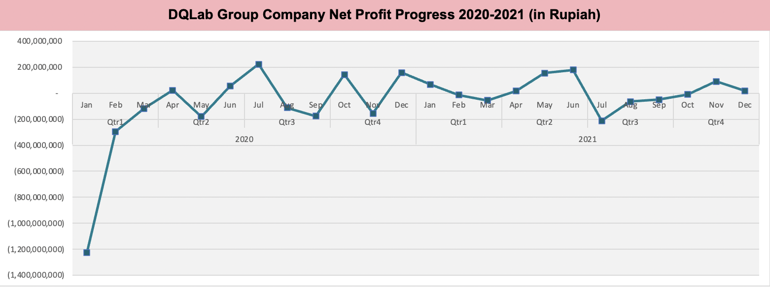
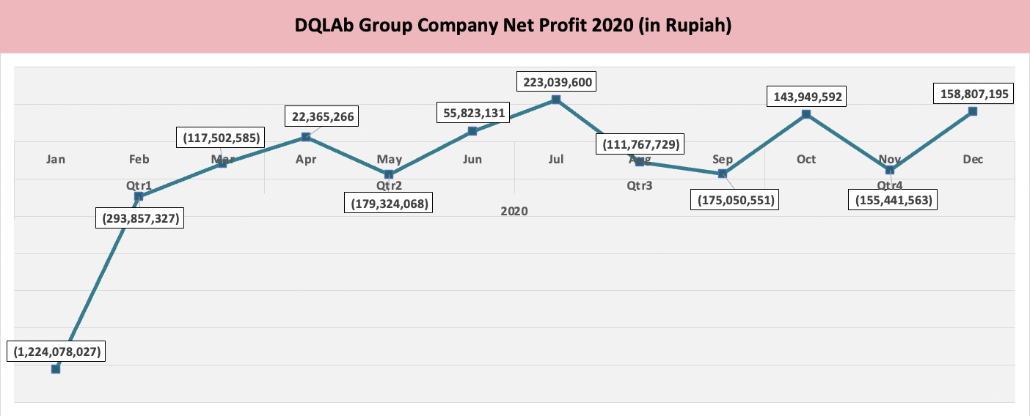
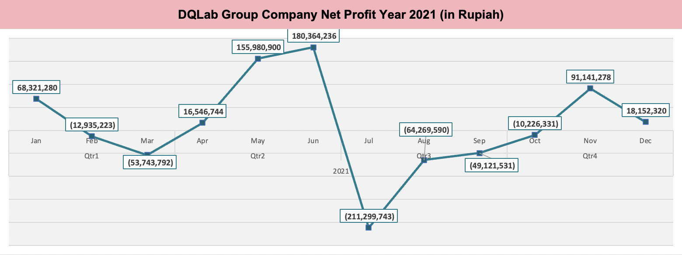
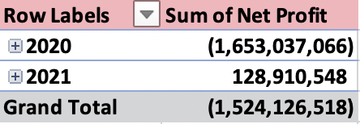
Sales Profit Progress
In 2020, sales profit still showed a negative value in the beginning of business run, with a total of minus 1,653,037,066 rupiahs this because the company didnt run effective inventory management to meet the costumer’s needs. Some items was overstocked, and left with costly excess inventory which hurts profitability.
Meanwhile in 2021, sales profit showed little improvement at positive accumulation with a total of 128,910,548 rupiahs.

Slide 6
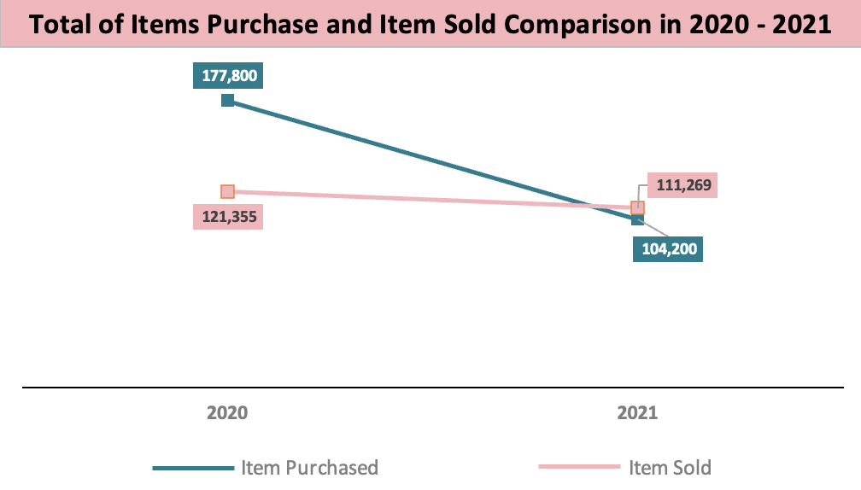
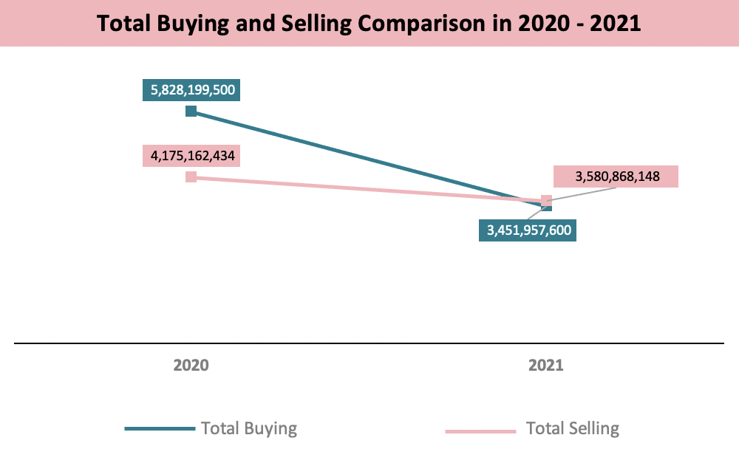
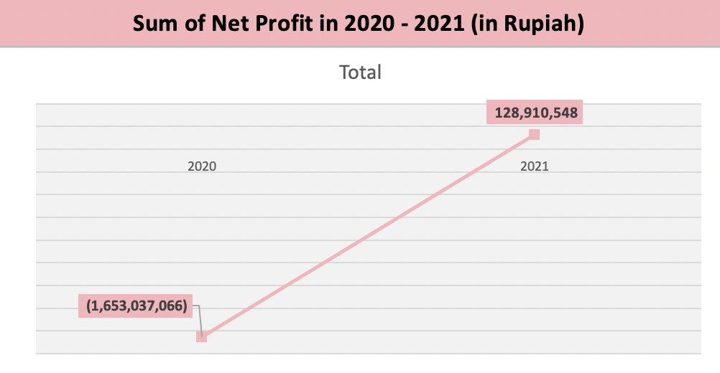
The way inventory managed at first year of business was negatively affect to profit/loss. In 2020, the stock of items purchase was excessive while the volume of items sold is still quite low. However, in 2021 the stock of item purchased is reduced in number, and the selling price was greater than the buying price, so the accumulated profit in 2021 is increased compared to 2020

Slide 7
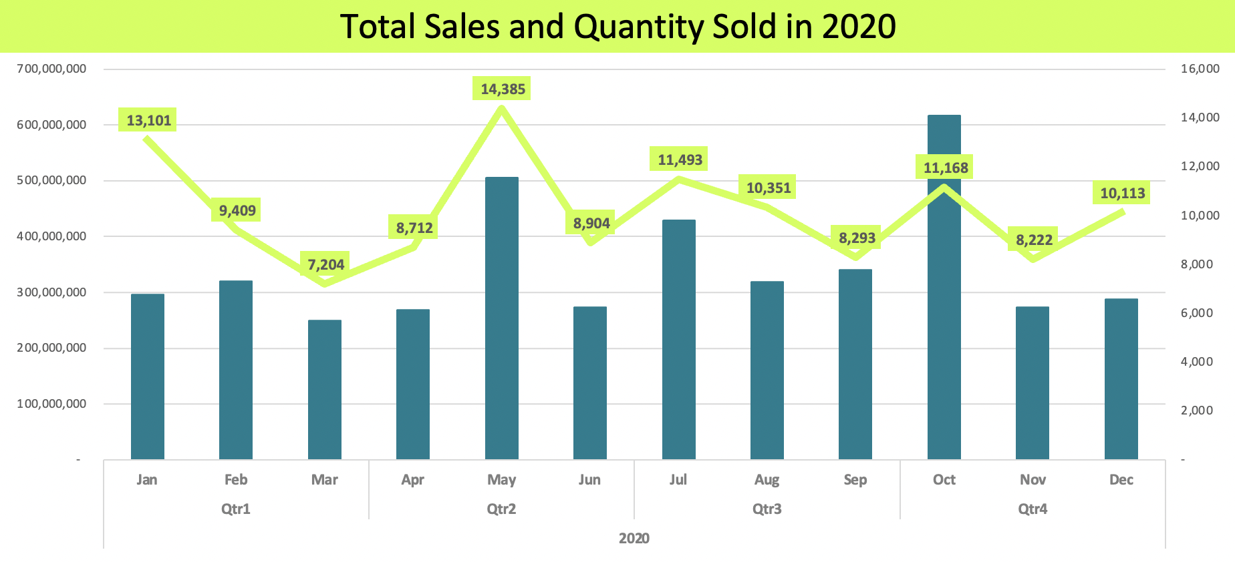
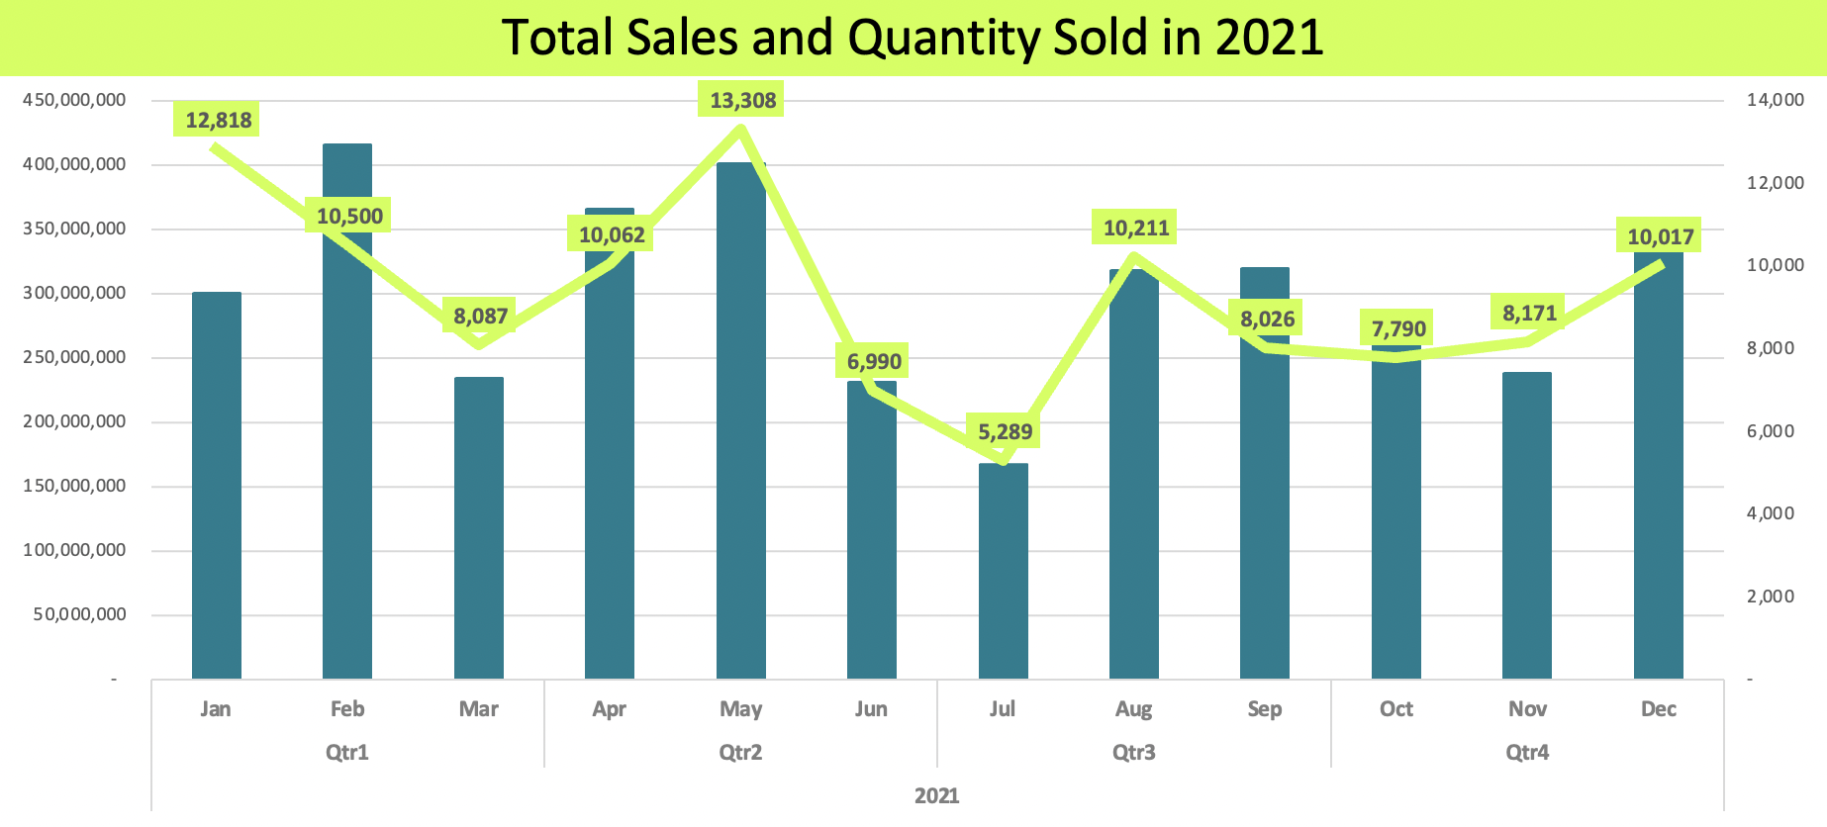
Total Sales and Quantity Sold Per Month
In 2020, the highest item sold was in May with total unit was 14,385. Similarly in 2021 the highest item sold also occurred in May with total 13,308 units. Thanks to ‘Obat sakit Kepala dan Demam’ who dominated quantity sold with more than 40% of total quantity sold.
There is no specific pattern or seasonal drug sales, as the higher quantity sold do not always reflect to higher sales as well. The highest sales was happened in October 2020 and Febuary 2021, both was due to high sales of ‘Obat Hipertensi’.
It can also be known, that the average item sold every month reaches almost 10,000 pieces.

Slide 8
Overview Drug Sales in 2020-2021
’Obat sakit kepala dan demam' and 'Obat batuk dan pilek' become the most sought after during 2020-2021. According to WHO, influenza and common cold are most illness that affect people in the world. The symptons are include: fever, headahace, dry cough and somestimes a stuffy nose. In tropical regions, influenza and common cold may occur throughout the year caused by change in weather and air pollution. Thus, the company expected to maintain stock availability to treat those two illness.
'Obat Hipertensi' became the most profitable due to high selling price. This opportunity should be used to sell more quantities of 'Obat Hipertensi' by highlighting product quality and educating potential buyers.
Meanwhile, the remain 27% sales consist of : ‘Obat Alergi’, ’Obat Kolesterol’ and ‘Obat Telinga’ sold with average sales 3000 units per month.

Slide 9
Top 10 Best Seller Drug Brands
The most selling drug brand during 2020-2021 are:
Decolsen with 9.2% and 21,400 of units sold,
BodrexExtra with 7.23% and 16,814 of units sold,
Ultraflu with 5.97% and 13,893 of units sold,
Paramex Tablet with 5.56% and 12,932 of units sold,
Dexteem with 5.37% and 12,496 of units sold.
These products were sold above 10,000 unit since customers have trust and positive opinion of its drug brand

Slide 10
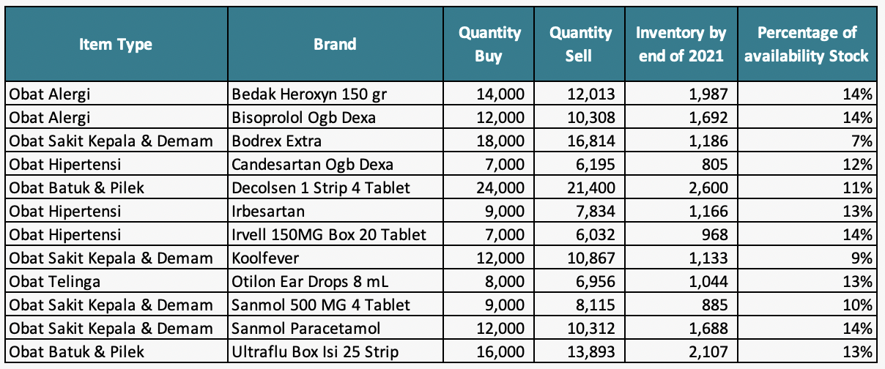
Restock Product by the end of 2021
Some particular Brand are in high demand due to its price, trademark, and public trust to the medical properties.
From the top 10 best selling products in 2020-2021, DQLab Group Company need to restock these products immediately, since the company need to keep the availability stock above 30% from the total demand (quantity sold). Otherwise, the company will carrying insufficient inventory to meet demand which can result in the loss of business and potentially, the loss of future business when customers buy elsewhere, if the product is in high demand or experiencing a shortage, sure it will may take longer for the pharmacy to restock it.

Slide 11
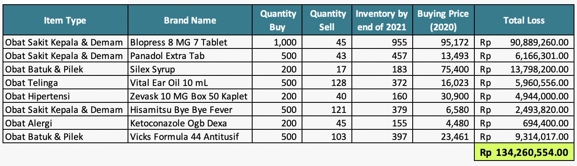
Dead Inventory by the end of 2021
Generally, pharmacies will restock their inventory on a regular basis to ensure that they have enough products to meet demand. However at the first year of business run, the DQLab Group were having overstock and left with excess inventory which hurts profitability.
The above detail products were bought in year 2020, and merely sold under 25% from the inventory up to December 2021, lead to bloated, slow-moving, and dead stock as well as excessive levels of expired drug. If the company decide to dispose those products due to it's expire date, accordingly the company will incur loss amounted to IDR 134,260,554

Slide 12
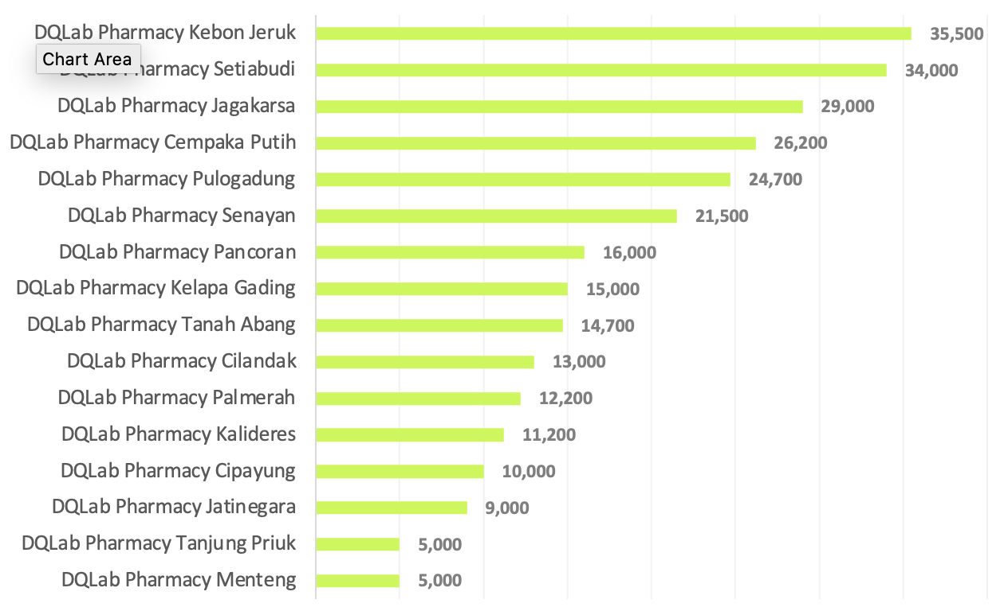
Top Tier Suppliers
During 2020-2021, DQLab Pharmacy Kebon Jeruk become the number one supplier with a total of 35,500 units. Consecutively there are DQLab Pharmacy Setiabudi, DQLab Pharmacy Jagakarsa, DQLab Pharmacy Cempaka Putih, DQLab Pharmacy Pulogadung, DQLab Pharmacy Senayan, and others are suppliers with a supply capacity of less than 20,000 units.

Slide 13
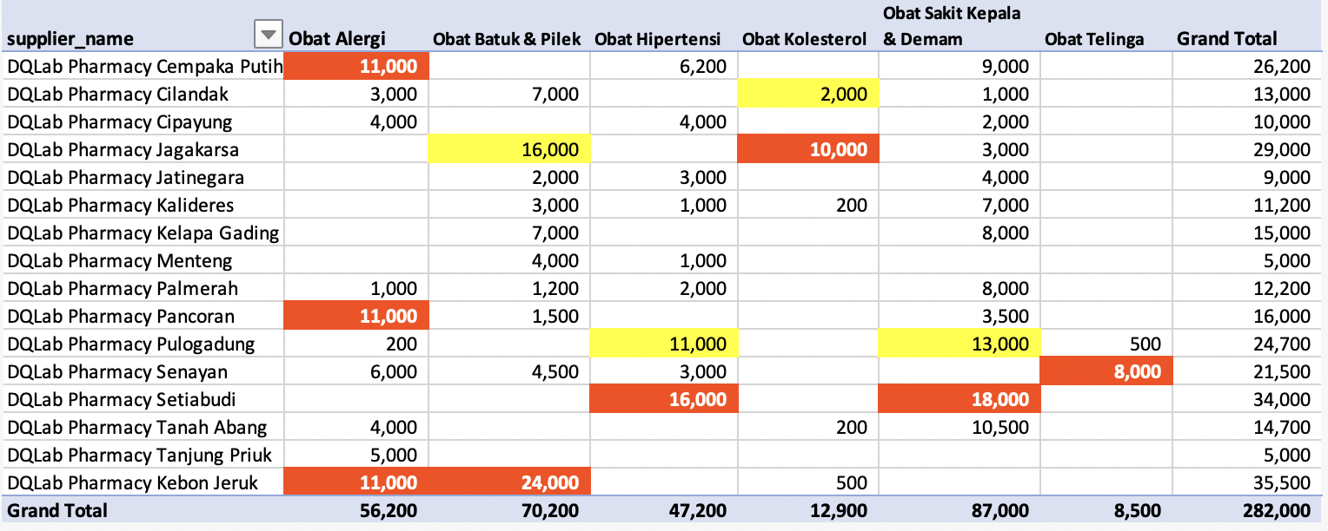
Main Supplier for Each Product Type
The main suppliers marked in red for each product type, for Obat Alergi are supplied from DQLab Pharmacy Cempaka Putih, Kebon Jeruk, and Pancoran; Obat Sakit Kepala & Demam are supplied from DQLab Pharmacy Kebon Jeruk; Obat Hipertensi are supplied from DQLab Pharmacy Setiabudi; Obat Kolesterol are supplied from DQLab Pharmacy Jagakarsa; Obat Sakit Kepala & Demam are supplied from DQLab Pharmacy Setiabudi; and Obat Terlinga are supplied from DQLab Pharmacy Senayan. While the yellow highlight is alternative supplier that can be choose as a reserve for the main supplier.

Slide 14
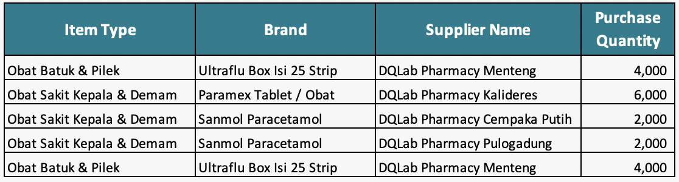
Consideration to change Supplier
The company need to consider to find alternate supplier for The Best Selling item in 2020-2021 as detailed above, since the current supplier has 28 days lead time, that could interfere forecast inventory, and planning customer demand.
Moreover, reduced in lead times can translate into improved fulfillment rates of orders, and also having the right balance to avoid overstock that can create larger problems as a whole.

Slide 15
At first year of business, DQLab Group suffered a huge loss due to excessive item purchase while sales volume was quite low. To deal with, the company must carrying the right inventories at the right levels, which can cover demand without overstocking by classify the inventory stock as below:
Recommendation
Fast-moving medications, are usually in the low-price segment and do not require large financial investments. Therefore, the company can ensure their availability in accordance with the demand, without the risk of overstock.
Slow-moving medications, are usually expensive and/or rare drugs. The company need to scheduling system that takes into account various factors, including demand, cost, expiration date of a particular batch of drugs.
The company must maintain the availability stock for best selling products above 30% from total demand.

Slide 16
Recommendation
In addition to effective inventory management meets the needs of customers the company need to assign supplier with 7- 14 days lead time for all kind of products.
The company must have smooth communication with DQLab Hospital and keep track of doctors prescription in order to get a repurchase medication and also prevent of unnecessary stock product.

